Slide 1

Fundamentals of Programming Using C - 15101104
Unit 5 : Pointer & String in C
Bhavika Vaghela
Assistant Professor
Parul Institute of Computer Application
Faculty of IT & Computer Science
Parul University

Slide 2

Pointer
Pointer a variable which is use to store address of variable of same data type.
Here address mean memory address.
When you declare any variable it will going to occupy some memory space/ block and that memory block have some address.
So you can also access that variable by passing memory address.
For store that memory address pointer is use.
Pointers are used to point to address the location of a variable. A pointer is declared by preceding the name of the pointer by an asterisk(*).

Slide 3
Cont..
Declare and initialize pointer variable
For declaring pointer :
<data type> *<name of pointer>;
<data type> *<name of pointer> = address of variable
int *ptr;
Int *ptr = &num; //where variable number is of int data type.
Address Operator “&” : Address Operator “&” gives memory address of variable.
Example of Pointer

Slide 4
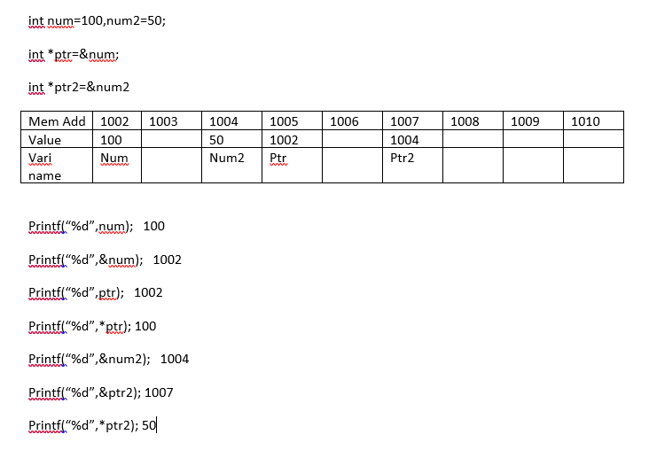
Cont..

Slide 5
Cont…
Types of pointer
Pointers to int objects
Pointers to char objects
Pointers to user-defined objects
(e.g., Rational Number)
Even pointers to pointers
Pointers to pointers to int objects

Slide 6
Double Pointer (Pointer to Pointer)
Pointers to Pointer (Double Pointer)
Is use to assign address of another pointer.
Example :
int num, *ptr;
int **db_ptr;
ptr = &num;
//Assigning address of another pointer
db_ptr = &ptr;
Program for double pointer.
Pointer | Value assign
int *p | &num1
int **ptr | &p
int ***nwptr | &ptr
int ****nw1ptr | &nwptr

Slide 7
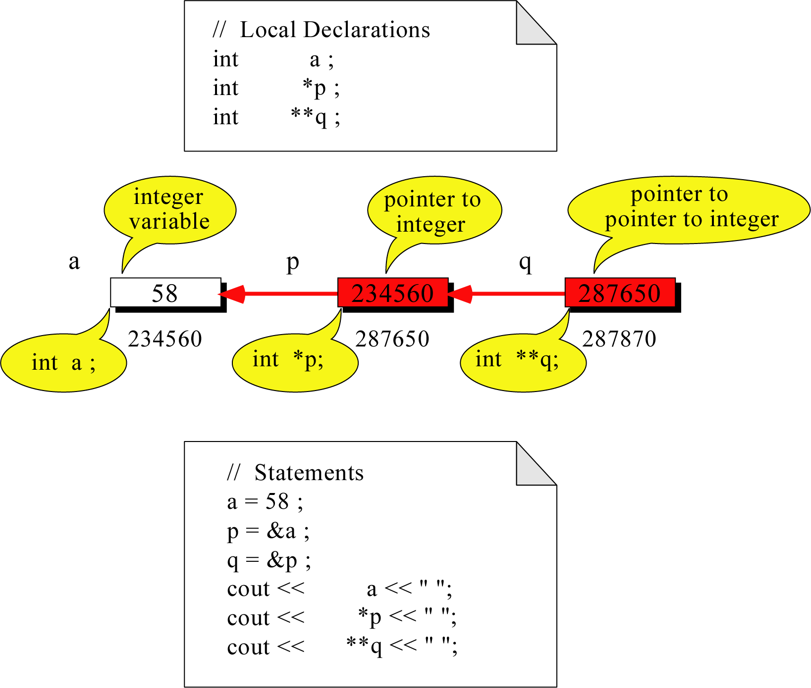
Example of pointer
Out put is : 58, 58, 58
Guess the Output

Slide 8
Pass pointer as an argument of UDF
One can call UDF or any other function in two different way
1. Call by value
When you call function with value original value not going to change.
2. Call by reference (pointer pass an argument)
When you call function with reference original value is going to change.
Example for swap value using call by value
Example for swap value using call by reference

Slide 9
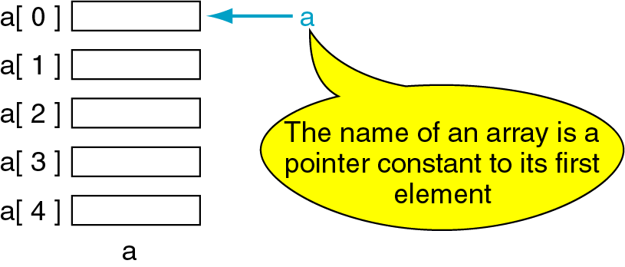
Pointer to array and array of pointer
Pointer to array : pointer points to array and access element of array using pointer.
Array of Pointer : create array of pointer to store address of different variable or different array.

Slide 10

Pointer to array
To access an array, any pointer to the first element can be used instead of the name of the array
We could replace *p by *a
#include <stdio.h>
void main(){
int a[5] = {2,4,6,8,22};
int *p = a;
printf(“%d”,*p);
printf(“%d”,a[i]);
}
a
p
a[0]
2
a[1]
4
2 2
a[2]
6
a[3]
8
a[4]
22
a

Slide 11
Cont…
Program to access 1D array element using pointer.
Like 1D we can access 2D array also using pointer
a[0] or *(a + 0)
2
a
a[1] or *(a + 1)
4
a + 1
a[2] or *(a + 2)
6
a + 2
a[3] or *(a + 3)
8
a + 3
a[4] or *(a + 4)
22
a + 4

Slide 12
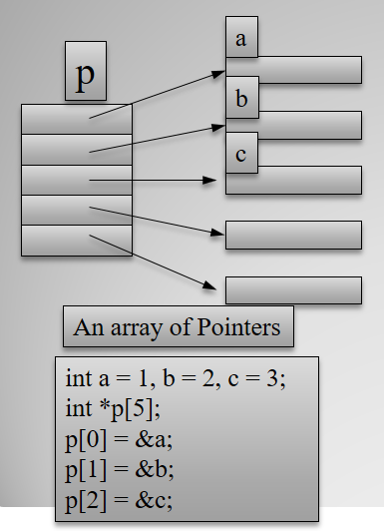
Array of Pointer
When one wants to assign address of different variable using single pointer name than array of pointer is useful.
One can also assign address of different array using array of pointer.
Program1
Program 2

Slide 13
String
String is collection of characters.
One can also say its sequence of character.
To store string one have to declare array of type char.
String must be enclosed with “ ” double quote.
E.g. If one write ‘h’ (is known as character) and “h” (is known as string).
Every string must end with one end character (null character “\0”).
So “\0” null character is assumed by the compiler as a end of string and it not going to read further once it found.
To perform string operation c have string.h header file. Which store the functions for string operations.

Slide 14
How to read string?
To read string one can use scanf() function but when you read string using scanf() it not going to read string once it get “ “ blank space.
One can also use gets() to read string but one problem in this method is it not going stop read if string reaches at the maximum length. It only going stop once it get new line character.
So to overcome the problem we have one more method fgets() function which is also use to read string.
puts() is use to print the string.
Like this we have so many functions.

Slide 15
Traversing string using null (\0) character
#include<stdio.h> void main () { char s[11] = “wel come to parul university"; int i = 0; int count = 0; while(s[i] !=‘\0’) { if(s[i]=='a' || s[i] == 'e' || s[i] == 'i' || s[i] == 'u' || s[i] == 'o') { count ++; } i++; } printf("The number of vowels %d",count); }

Slide 16
String function
Function | Description
strlen(string_name) | returns the length of string name.
strcpy(destination, source) | copies the contents of source string to destination string.
strcat(first_string, second_string) | concats or joins first string with second string. The result of the string is stored in first string.
strcmp(first_string, second_string) | compares the first string with second string. If both strings are same, it returns 0.
strrev(string) | returns reverse string.
strlwr(string) | returns string characters in lowercase.
strupr(string) | returns string characters in uppercase.

Slide 17
Find length of string without using strlen()
#include<stdio.h> void main () { char s[30]; int i = 0, count = 0; clrscr(); printf(“\n enter any string : ”); fgets(s,sizeof(s),stdin); while(s[i] !=‘\0’) { count++; i++; } printf(“Length of string : %d", count); }

Slide 18
Programs using function of string
//Program to find length of string copy string in another string variable #include<stdio.h> #include <string.h> int main() { char ch[20], ch2[20]; clrscr(); printf(“\n enter string : ”); gets(ch); printf("Length of string is: %d",strlen(ch)); strcpy(ch2,ch); //here we copy content of ch to ch2 printf(“\n copied string is : %s”,ch2); return 0; }

Slide 19
C String Concatenation
String concatenation mean join (concatenate) two different string.
If “hello” and “good morning” is two different string than third string is “hello good morning” is going to print after performing concatenation operation on string.
#include<stdio.h> #include <string.h> int main() { char ch[20]=“hello”; char ch2[ ]=“how are you”; strcat(ch,ch2); //it going to concatenate ch2 in ch; printf("Value of first string is: %s",ch); return 0; }

